Slide 1
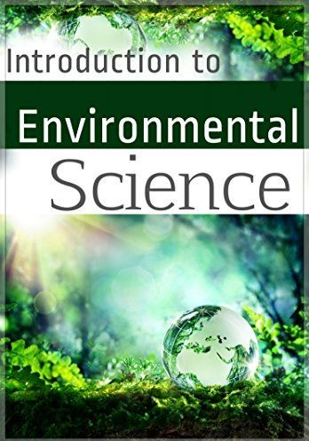
(एबिललटी एनहाांसमेंट कां पल्सरी कोसस (ए.इ.सी.सी. - पयासिरण अध्ययन)
Six-Month- Ability
Enhancement Compulsory Course (AECC-I) Environmental Studies at Undergraduate Level
Studies
Arun kr Yadav
Dept of EVS, University of Delhi

Slide 2
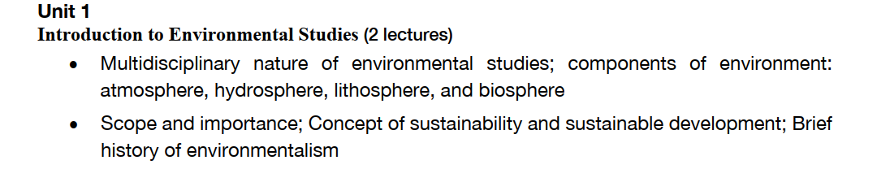
Unit 1: Introduction to environmental studies
Multidisciplinary nature of environmental studies
Scope and importance; Concept of sustainability and sustainable development.

Slide 3
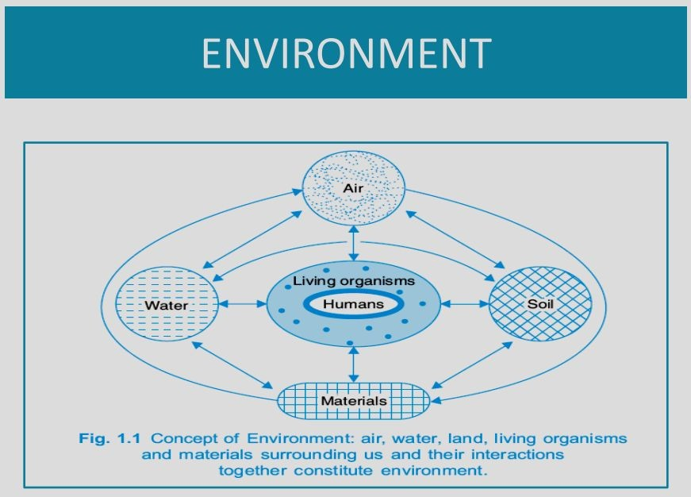

Slide 5
ENVIRONMENTAL STUDIES
The word environment is derived from the French word “Environ” meansinggni SSdunrurooundings .
Every organisms is surrounded by materials and forces which constitute its environment.
Environment creates favourable conditions for the existence and development of living organisms.
Environment – The sum of total of all the living and non-living things around us influencing one another.

Slide 6
Environmental studies deals with every issue that affects an organism. It is essentially a multidisciplinary approach that brings about an appreciation of our natural world and human impacts on its integrity.
It is the branch of studies concerned with the relations between organisms and their environment.
Literally, environment means the surrounding external conditions influencing development or growth of people, animal or plants; living or working conditions etc.

Slide 7
Types of Environment
Natural environment
Natural environment is characterized by natural components.
All biotic (living) and abiotic (non-living) are created through a natural process.
Natural components do not require any human support.
Non renewable resources, such as minerals and oil are those which will be exhausted in the future if we continue to extract these without a thought for subsequent generations.
Renewable resources, such as timber and water, are those which can be used but can be regenerated by natural processes such as regrowth or rainfall.

Slide 8
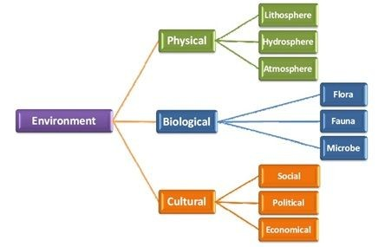
Types of Environment

Slide 9
Man-made environment
It is powerful environment modified using modern technologies according to the needs created by humans.
Components of the Environment
Abiotic or Non-living components
Biotic or Living components
Energy components

Slide 10
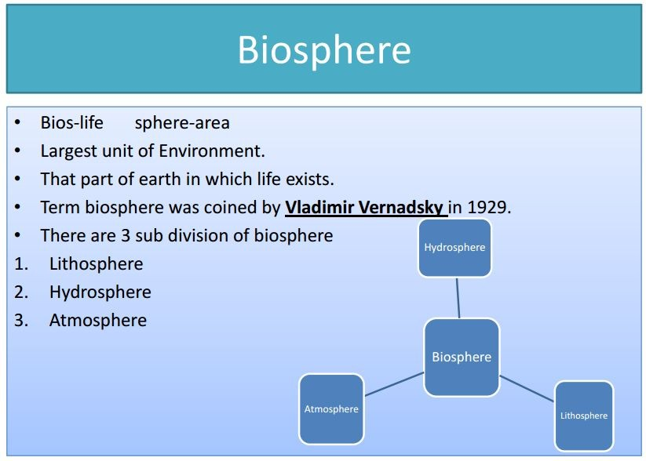

Slide 11
Biotic or Living components
Example: Animals, plants and micro organisms.
Biosphere:
The living organism live and interact with physical environment (soil, water and air) is called biosphere.
Functions:
Plants ↔ animals

Slide 12
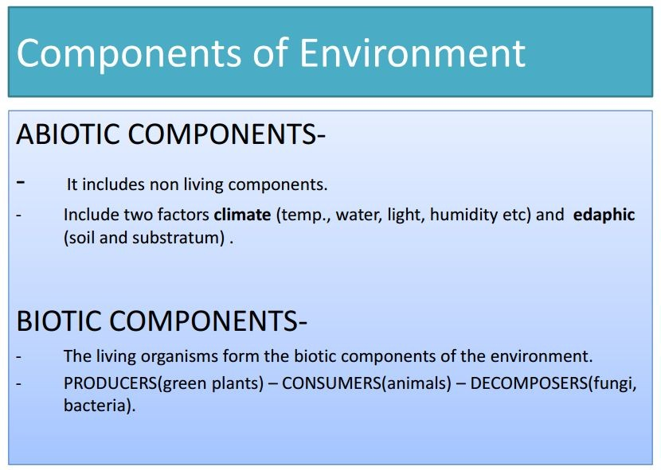

Slide 13
Abiotic or Non-living or Physical components
Example : Air, water, soil and minerals.
Abiotic components enter the body of living organisms directly or indirectly take part in metabolic activities and then return to the environment.

Slide 14
Abiotic – three categories
Atmosphere
Lithosphere
Hydrosphere
1. Atmosphere
Air envelopes the earth is known as atmosphere. It extends up to 500 kms from the earth surface.
It comprises 78% of Nitrogen, 21% of oxygen and 1% of other gases.

Slide 15
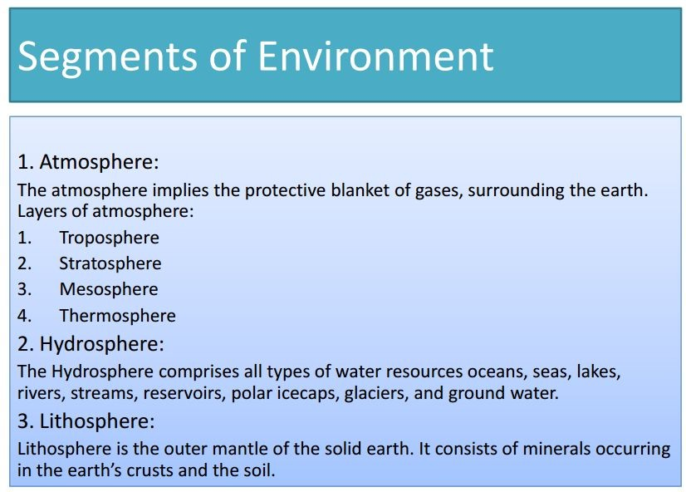

Slide 16
Structure of atmosphere
Sl no. | Region | Altitude in km | Temperature in C | Chemical species
1 | Troposhere | 0-18 | 15 to -56 | N2,H2O,CO2, O2
2 | Stratosphere | 18-50 | -56 to -2 | Ozone
3 | Mesosphere | 50-85 | -2 to -92 | NO+, O2+
4 | Thermosphere | 85-500 | -92 to 1200 | NO+, O+, O2+
5 | Exosphere | Upto 1600 | Very high | He, H2

Slide 17
Composition of Atmospheric Air
Gas | Relative %by Volume
Nitrogen (N2)- | 78.09
Oxygen (O2)- | 20.93
Argon (A)- | 00.93
Carbon-di-oxide- (CO2)- |  | 0.032
Miscellaneous- |  | 0.02
Total |  | 100.000

Slide 18
Functions of atmosphere
It maintains the heat balance on the earth by absorbing the IR radiations
The gaseous constituents play an important role in sustaining life on earth
Oxygen - supports life of living organisms
CO₂- essential for photosynthetic activity of plants
Nitrogen – essential nutrient for plant growth

Slide 19
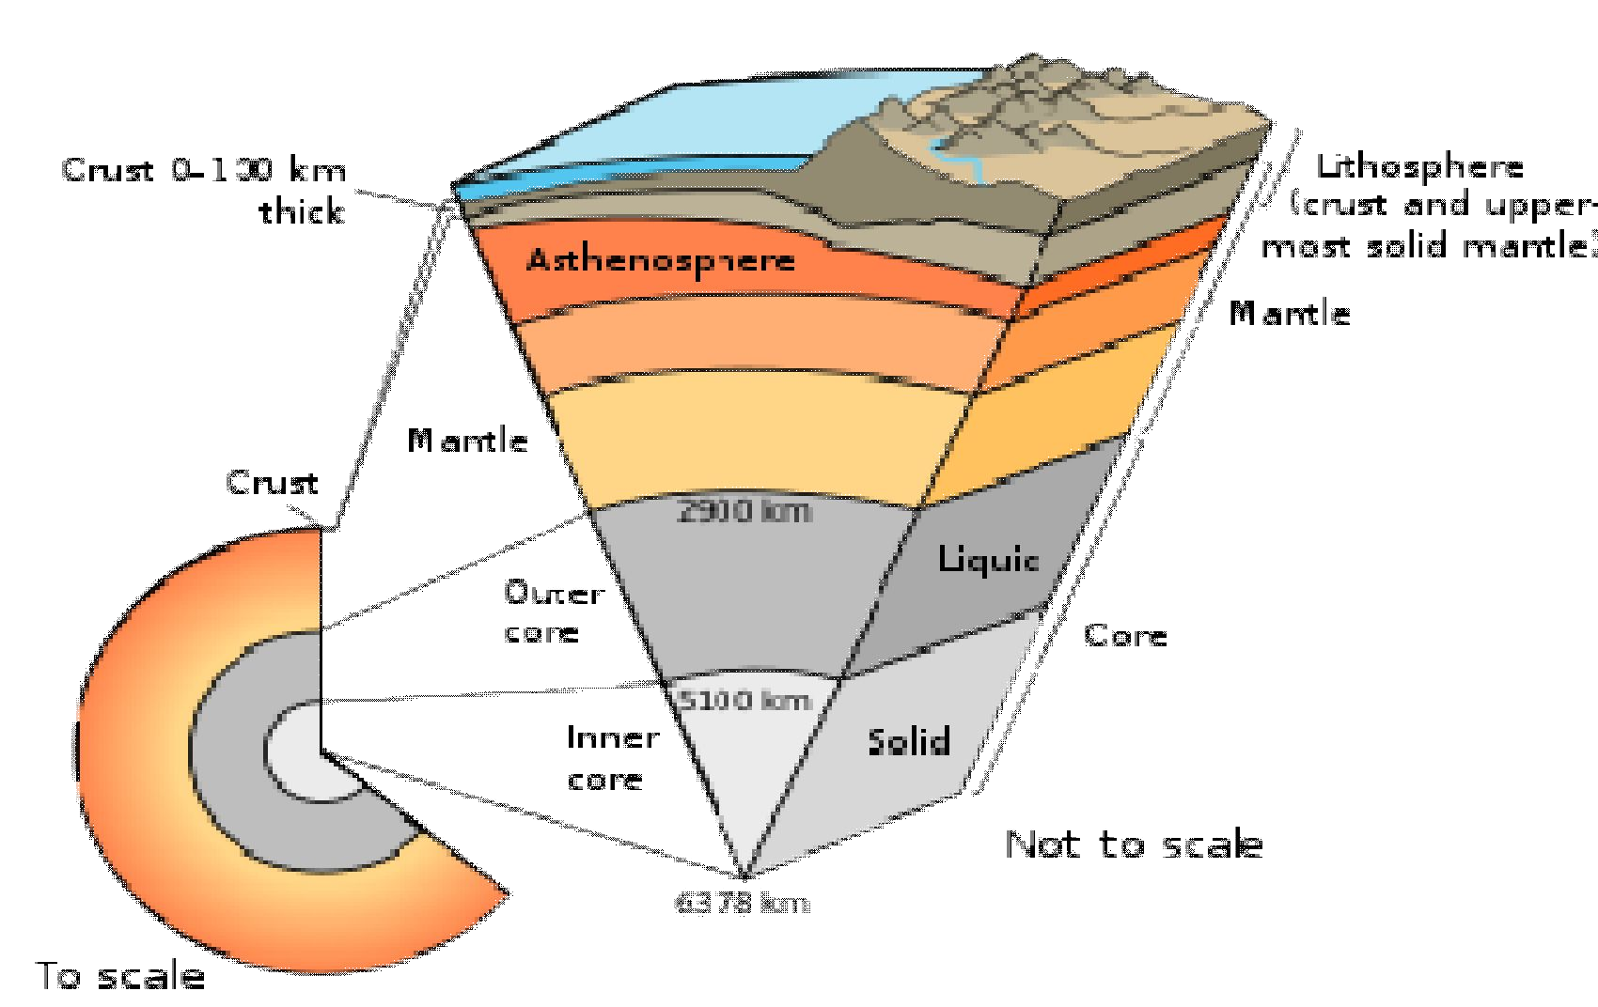
Lithosphere
The soil and rock components of the earth
Functions :
Home for human beings and wildlife
Storehouse of minerals and organic matter

Slide 20
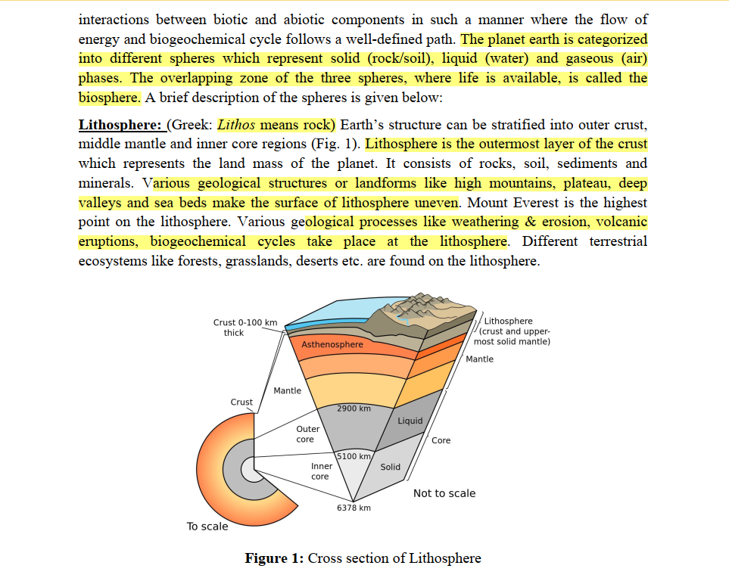

Slide 21
Hydrosphere
The aqueous envelope of the earth . Oceans,
lakes,streams,rivers and water constitute hydrosphere.
97% of earth water is in oceans. available as fresh water.
Functions :
vapour
3% is
It is used for drinking purpose and also supports the aquatic life.
It is also used for irrigation, power production, industries and transport.

Slide 22
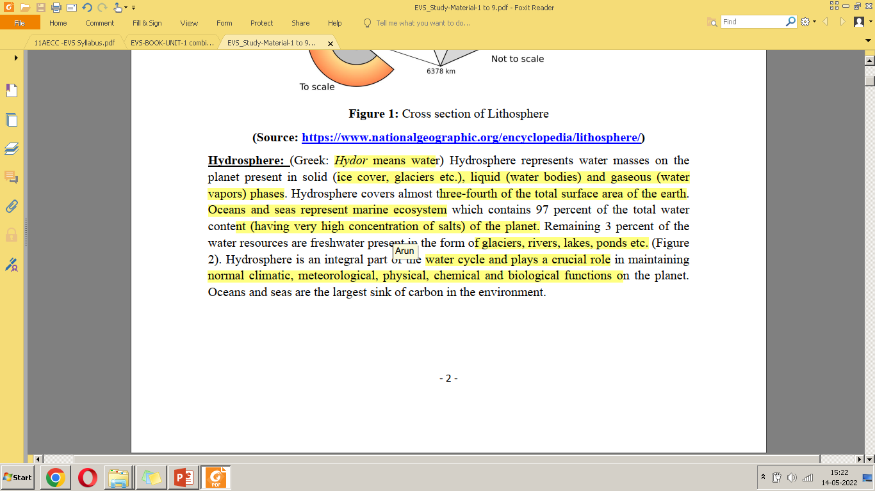
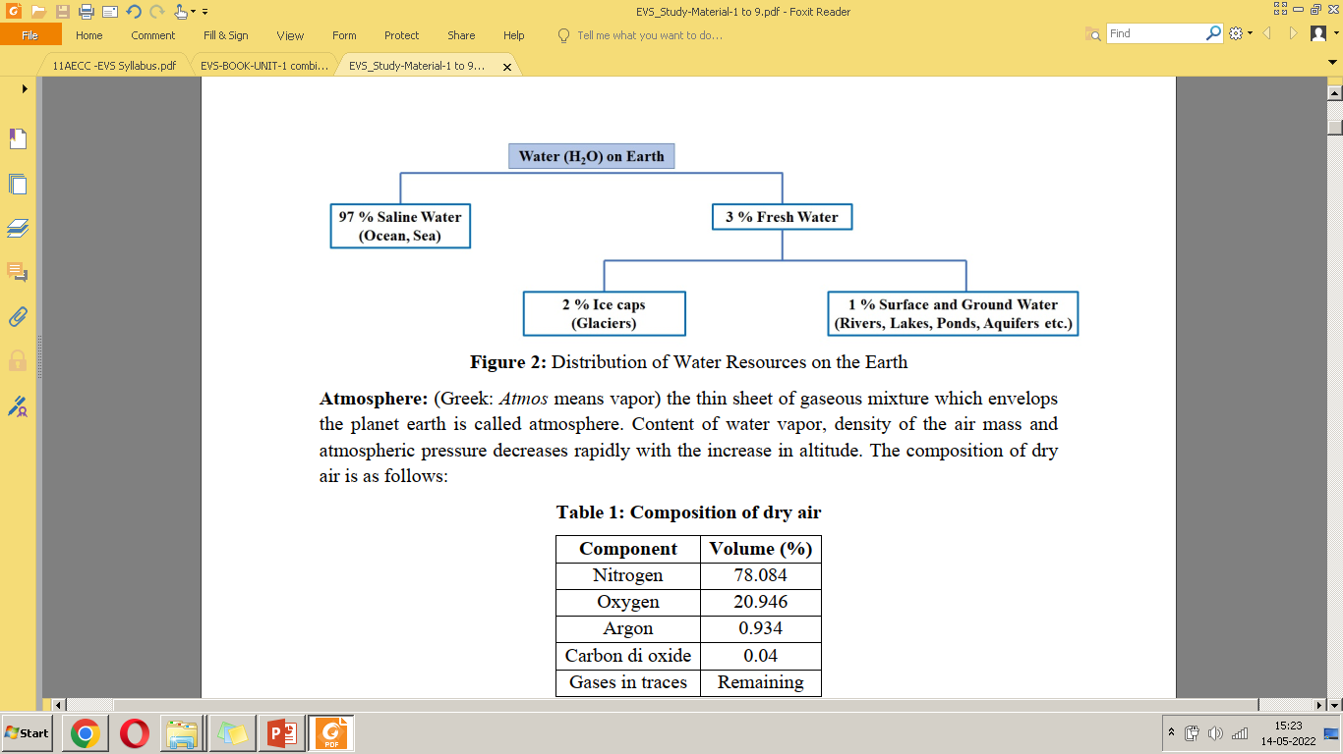

Slide 23
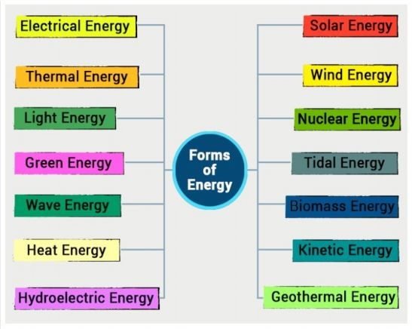
Energy components
The components of energy flows across biotic and abiotic components .
Example : Solar energy,
Nuclear energy, Geochemical energy, Thermo electrical energy, etc.

Slide 24
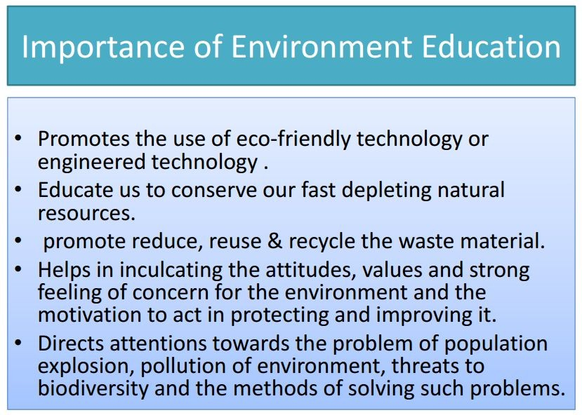

Slide 25
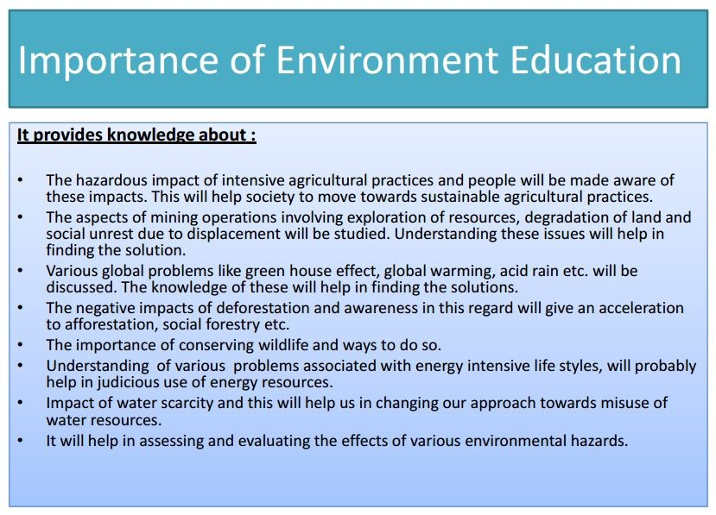

Slide 26
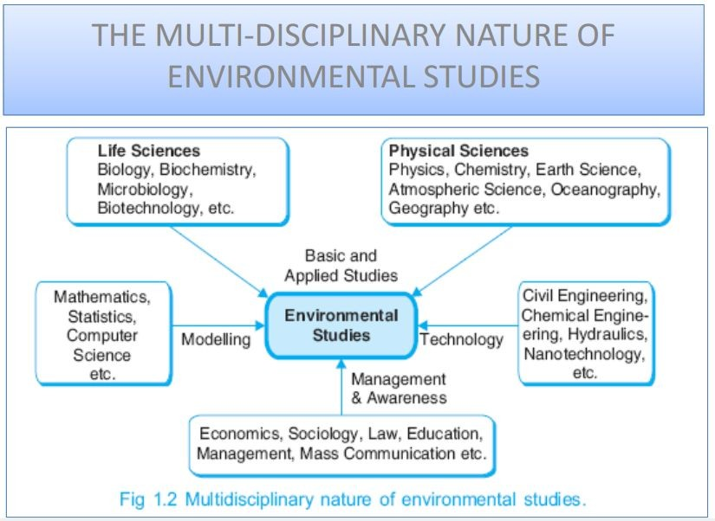

Slide 27
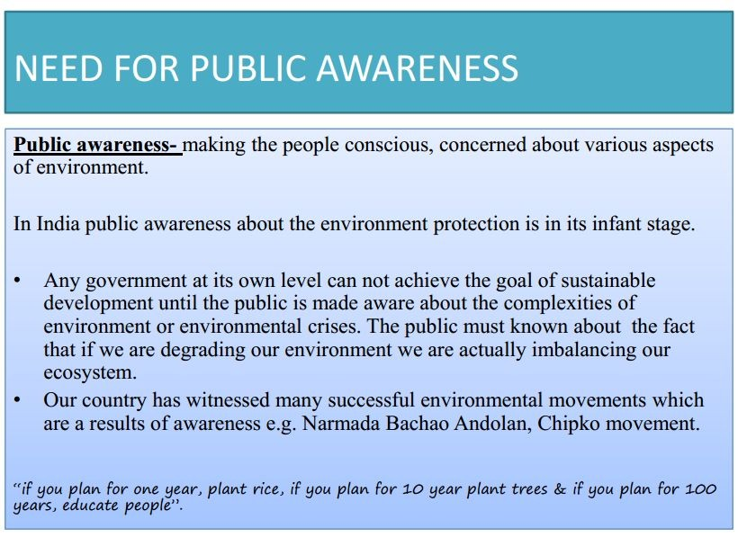

Slide 28
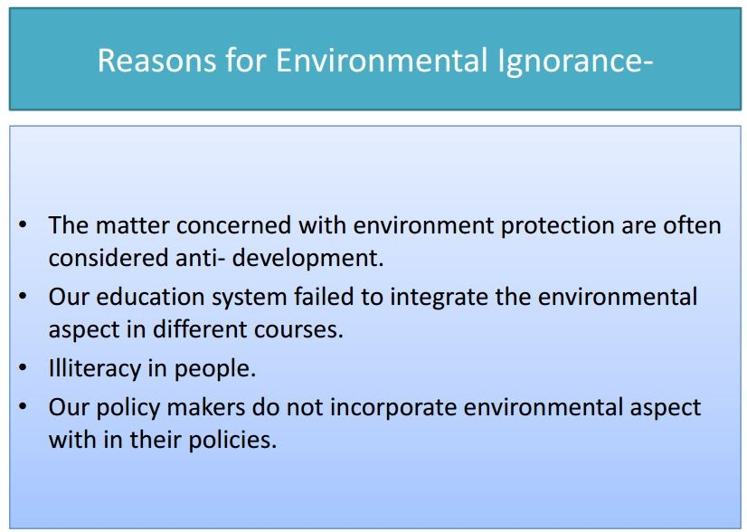

Slide 29
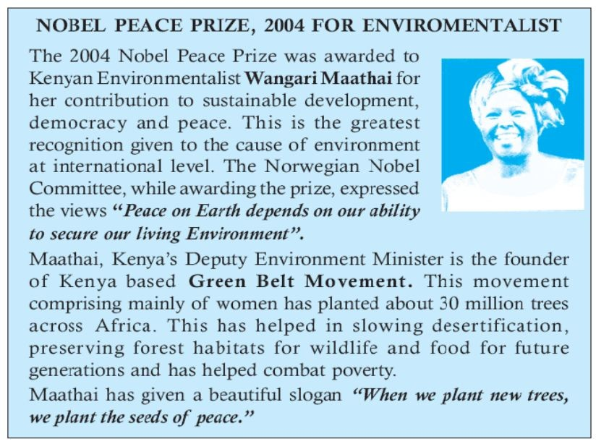

Slide 30
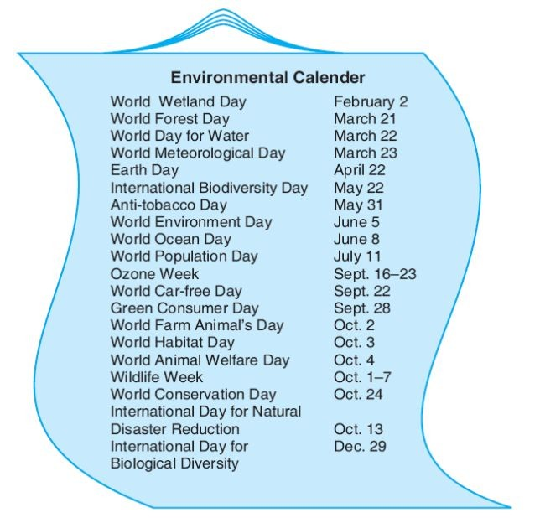

Slide 31
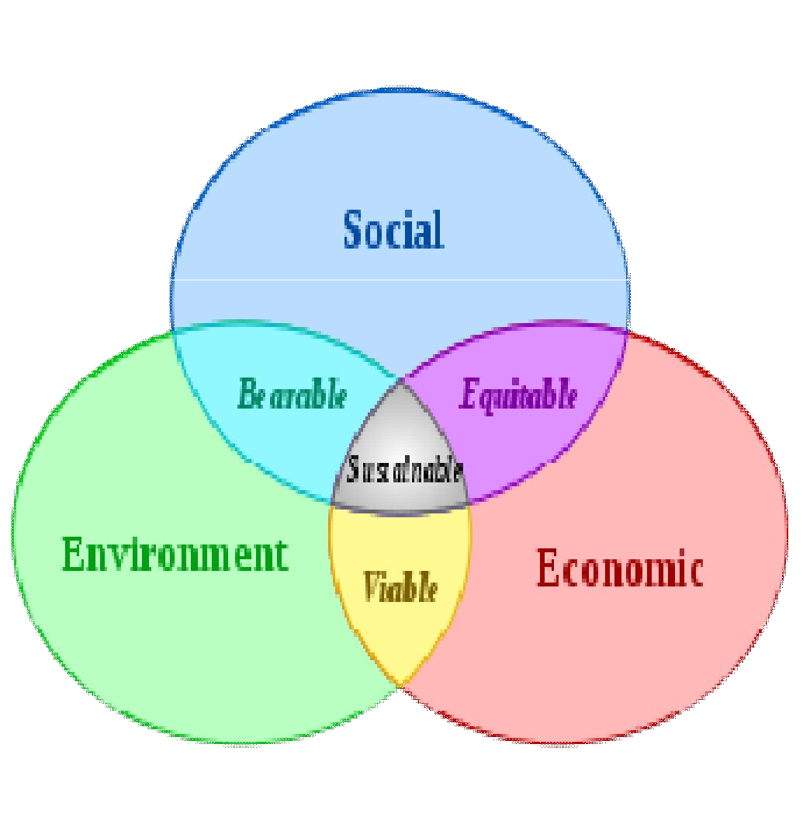
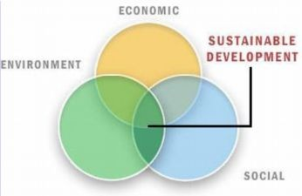
Sustainable development
Sustainable development is defined as Development that meets the needs of the present without compromising the ability of future generations.
It also looks at the equity between countries, races and gender and ages.
It includes development requirements other.
social and economic
on one hand
and the
of environment on the
It is a process which leads to a better quality of life while reducing the impact on the environment.

Slide 32


Slide 33


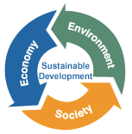

Sustainable development
Causes
Raising population
Increasing poverty
Pollution loads
Measures to be taken
Any economic activity
Use of appropriate Technology
Minimize the use of resources
Creating awareness
without healthy
balance between
environment leads to
Unsustainability
Discourage earth degrading behavior
Govt Programmes to reduce population, poverty and pollution

Slide 34
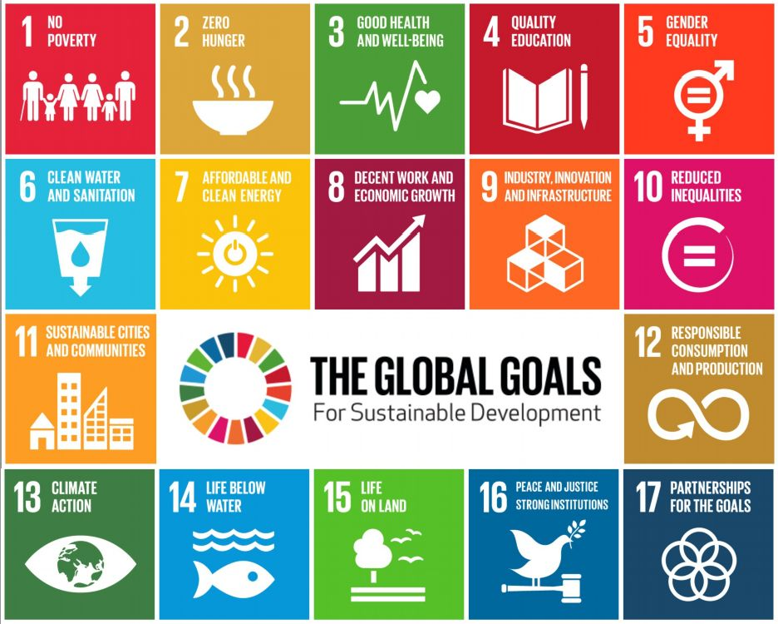

Slide 35
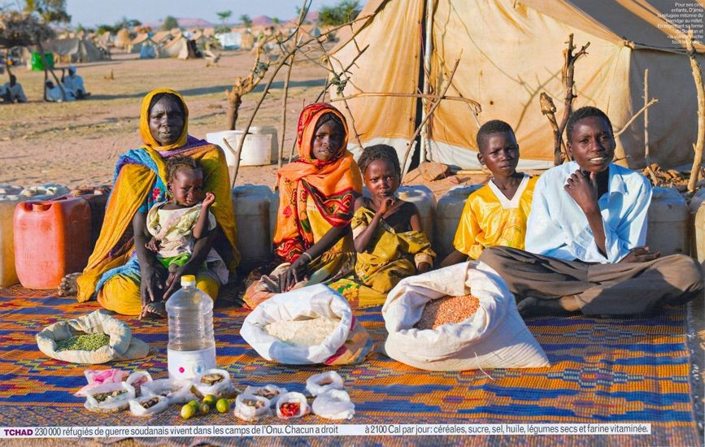
Food for a Week, Darfur Refugees, Chad, Africa
Source: Menzel, 2005

Slide 36
Food for a Week, for German Family
© 2005 PETER MENZEL PHOTOGRAPHY
Source: Menzel, 2005

Slide 37




